Slide 1





OurBusiness
PLAN

Slide 2



Funamentals
Rakcha blooming is pleased to inform its fortune plan. A few
terminologies you need to be familiar with.

Slide 3


Every product will have a define MRP, CP, BV, CV, PBV, AGBV, CMGBV, GLAND SV
MRP : MAXIMUM RETAIL PRICE is the price that customer pays you, as labeled on each product.
CP : CONSULTANT/DISTRIBUTOR PRICE is
the price you pay to Rakchablooming
While purchasing a product
BV : Business Volume is point assigned to each Rakcha blooming product. This point is related to the value of the product

Slide 4



CV : Commissionable value is an earned
amount equal to BV where the earnings are based on CV
25
PBV : Personal Business volume is equal to Sum of BV of each individual
20
AGBV: Accumulation Group Business Volume is equal to Total Sum of BV earned by each individual and Group t i l l 14%.
15
10
5
CMGBV: Current Month Group Business Volume is equal to Total Sum of BV earned
By each individual and Group for the Current month.
0
2018 2019 2020 2021 2022

Slide 5

GL: Growth Leg is when an
individual having a Con. Manager and above in a group of
any particular group
SV: Side Volume is sum of BV and PBV other than the Growth Leg

Slide 6




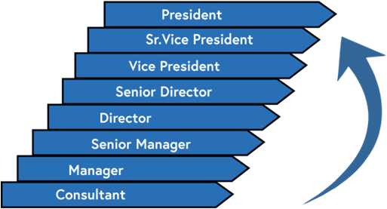
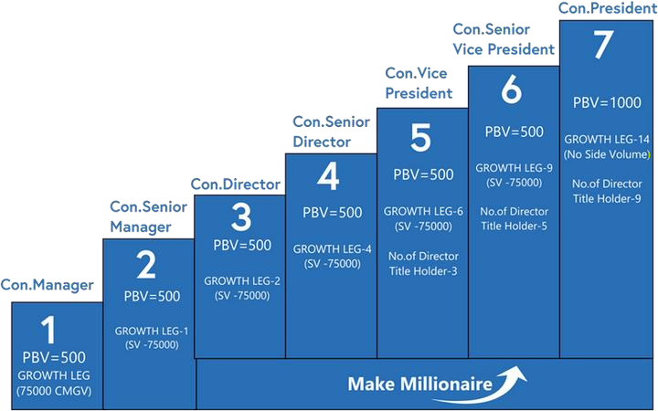
Title Description
Paid as Title
Title achieved by an individual for the current month for bonus calculation
Star Title
Highest Title achieved by an individual 5 times for the time period of previous 12 months.
Founder Title
Highest Title achieved by an individual 9 times for the time period of previous 12months.
Rolling Title
Highest Title achieved by an individual for the time period of previous 12months.

Slide 7

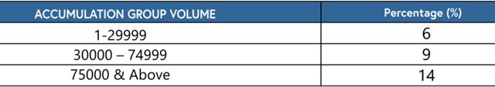

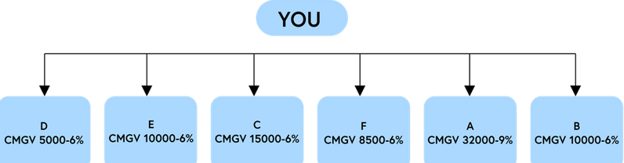
1.PURCHASE PROFIT ( 20 % – 33 %)
Difference of MRP and CP
2.PERFORMANCE BONUS ( 6 % - 14%)
  Performance Bonus is paid on your Group Volume(GV)
Percentage of PB growth is based on the Accumulation BV all other benefits are based on current month BV
Growth Leg GV is not added
The table below gives you the Detailed Accumulation performance bonus
PB CALCULATION
PBV – 500, CMGV – 81000
( CON.MANAGER) A GROWTHLEG AND 14%

Slide 8
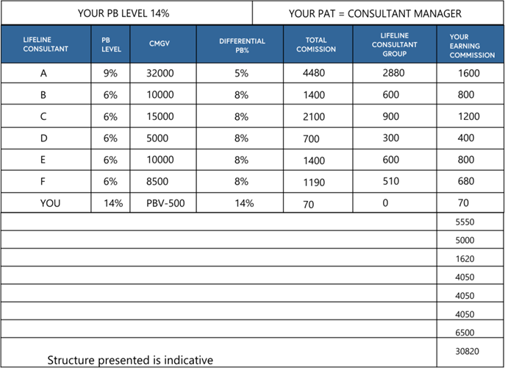

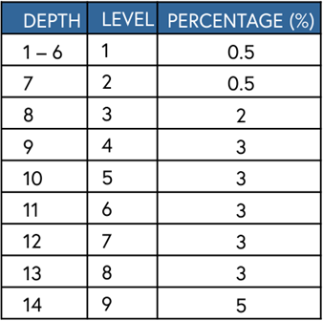
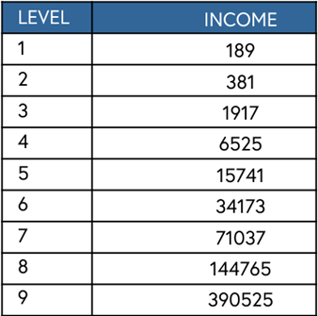
3.NETWORK BONUS (23%)
To eligible Network Bonus An Individual and 2 members from different line should complete each 300 BV current month
To Attain the seniority level in Network Bonus an individual should eligible for Network bonus at the earliest
To maintain the Network Bonus an Individual should eligible for network bonus every month if not the individual will exit from the network tree automatically, Again if the individual eligible for the network bonus the tree placement will be in
the current last place
In network bonus total Rakcha consultants will be considered as single team
Performance bonus earning is the differential between you and your first level downlines

Slide 9

4.MANAGER BONUS ( 2 %)
Manager bonus is calculated every month as 2% from current month total company BV and split and paid for all the current month con.managers equally

Slide 10

5. TOUR BONUS
Tour bonus is calculated every month as 5% from current month total company BV and split and paid for all the current month any paid as title holders equally based on Tour bonus points The Tour bonus for the tour will be saved by the company .If shortage of amount till 30% for the tour expense can be paid by the individual and avail the tour.package, If not after the tour completed the individual may receive the tour bonus after a month or else the individual may use the tour bonus for the next trip

Slide 11

6.
CAR BONUS ( 5 %)
Car bonus is calculated every month as 5% from current month total company BV and split and paid for all the current month Con.managers and any star title holders equally based on Car bonus points

Slide 12

7.
HOUSE BONUS ( 5 %)
House bonus is calculated every month as 5% from current month total company BV and split and paid for all the current month Con.managers and any Founder title holders equally based on House bonus points

Slide 13
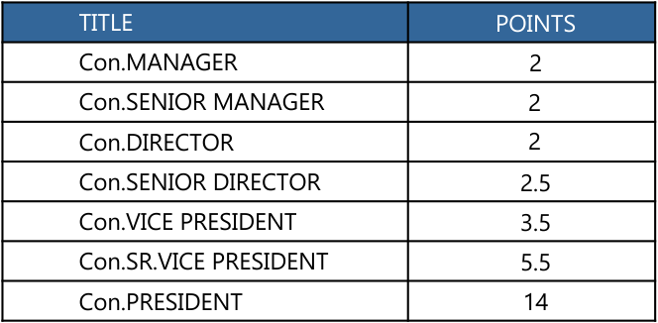
The table below gives you the detailed TOUR, CAR & HOUSE BONUS Points

Slide 14

8. LEADERSHIP BONUS (12%)
Leadership bonus is calculated every month as 12%from current month total company BV and split and paid for all the current month Con.Sr.managers and above equally based on Leadership bonus points

Slide 15

9.COMMITTEE BONUS (9%)
Committee bonus is calculated every month as 9% from current month total company BV and split and paid for all the current month all committee members equally based on Committee bonus points

Slide 16

  PAID AS PRESIDENT BONUS (2%)
Paid as president bonus is calculated every month as 2%from current month total company BV and split and paid for all the current month President Title holders equally.

Slide 17

STAR PRESIDENT BONUS (2%)
Star president bonus is calculated every month as 2% from current month
Total company BV and split and paid for all the current month Star President Title holders equally.

Slide 18
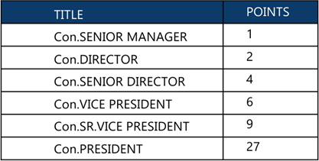
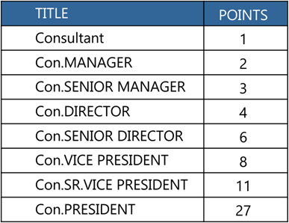
The table below gives you the detailed Leadership BONUS Points

Slide 19

12.Guaranteed Royalty bonus
Guaranteed Royalty bonus is calculated every month
as 2% from current month total companybBV and split
and paid for all the current month Founder President Title
holders equally.
POSTSCRIPT
1. When an individual attains commission of Rs.500/- and above, the individual is eligible for earnings and amount will be credited in the individual’s bank account within 5 working days of every month, otherwise the commission amount will be converted into voucher for product purchase
2. For the commission eligibility into bank account an individual should purchase at least 300 BV (approx Rs. 600 and above) or else the commission amount will be converted as voucher for product purchase
3. Commission earned is inclusive of all taxes
4. Title recognition is based on achieving a title for 3 times

Slide 20



Contact
Us
Office
RAKCHA BLOOMING
Fmcg Private Limited,456/123
Angammal Colony,
Salem - 636009
Phone
+91 93444 76926
Email
info@rakcha.in

